Slide 1


Accessibility in communicating science
Notes:
Hi, welcome to our session on accessibility in communicating science. Part of our job as scientists is to communicate our research, whether that’s giving presentations and designing posters for conferences, giving seminars, writing articles, posting on websites, or writing research papers with figures of our data. It’s something we all do, and sadly, a lot of the communication of science I see at conferences or in papers is inaccessible to a lot of people. Alicia & I aren’t complete experts but we both work quite hard to try to make as much of our content accessible so we’re going to share the most important things to consider, most of which are based on real complaints we’ve had & heard from a variety of people, and some really useful resources with you :)

Slide 2
What we’ll cover
1.
4.
Colour Schemes
Design
2.
5.
Fonts
Screen reading
Accessibility
checker
3.
6.
Figures

Slide 3
Colour Schemes
Choice of colour scheme should consider:
How you use your colour scheme
If colours can be easily distinguished
Colour contrast for text and background
Notes:
If your colour scheme is being used for a presentation, you may need to check different accessibility features compared to using it to make a figure or a graphic. You should check that colours can be easily distinguished from each other if they need to be, and the colour contrast between text and background needs to be considered for presentations or posters. If colour is purely decorative on a slide, then it is normally fine to have a colour scheme that doesn’t have a high contrast between your accent colours

Slide 4
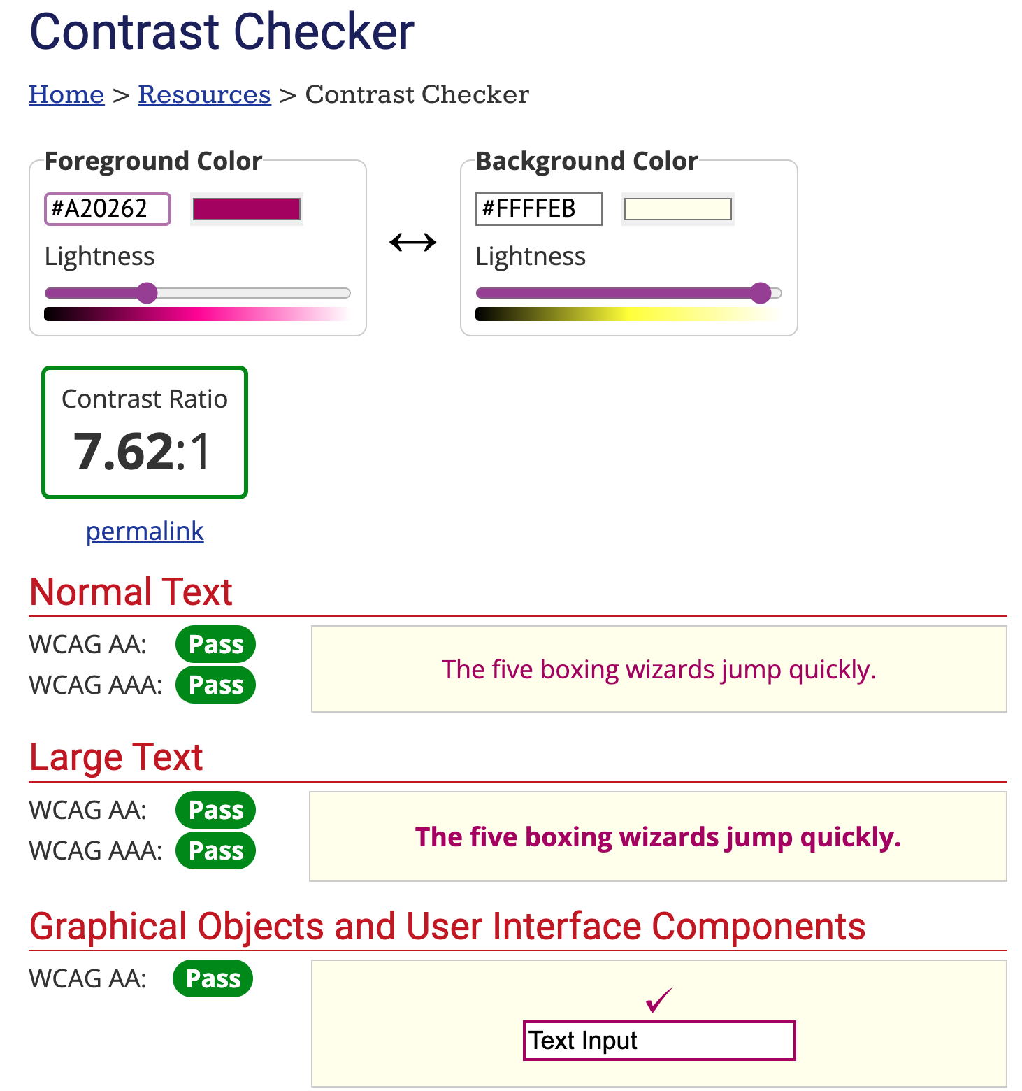
Checking Contrast
WebAIM contrast checker
Input Hex colours
Checks contrast for text, large text, and graphics
https://webaim.org/resources/contrastchecker/
Notes:
There are easy ways to check if your colour contrast is good enough, one is this online tool called WebAIM contrast checker, where you input hex colours and it will check the contrast for text, large test and graphics

Slide 5
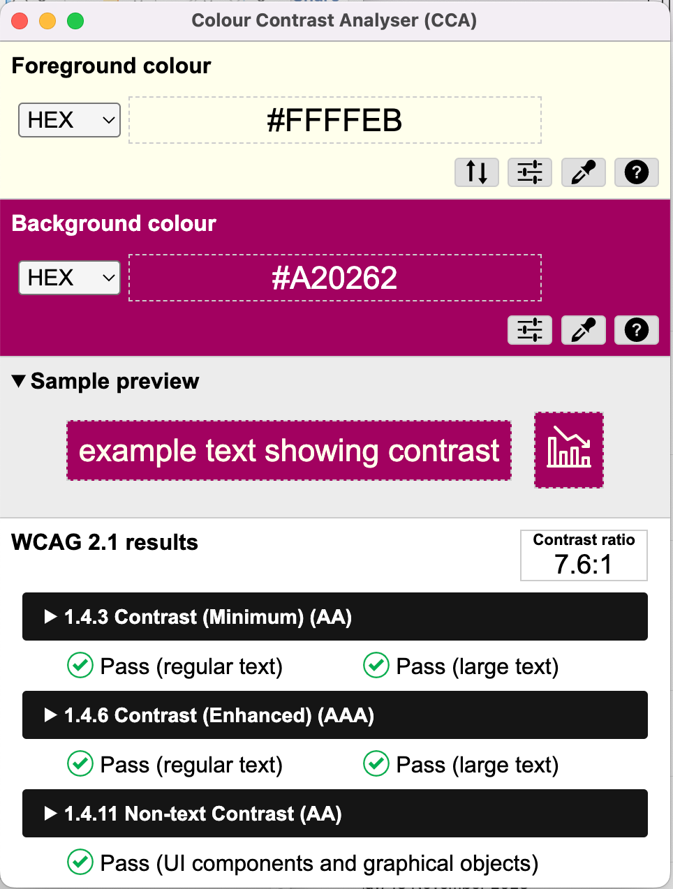
Checking Contrast
Colour Contrast Analyser
Input Hex colours or use eyedropper tool
Checks contrast for text, large text, and graphics
https://www.tpgi.com/color-contrast-checker/
Notes:
Another one that I prefer is colour contrast analyser, it’s free to download and you can input hex colours, use sliders, or use an eyedropper tool to get your desired colours and it checks contrast for graphics, text, large text, and checks enhanced contrast for text as well. For example, for the colour scheme that we chose for this presentation this tool showed us that our lightest pink and lighter oranges don’t comply with colour contrast so they are only used for decoration and not text!

Slide 6
Colour Schemes
It can be tempting to avoid thinking about colour
Black text on a white background is often inaccessible
Off-white backgrounds are easier
Notes:
I know that it can seem like this is a lot of extra work, but really you only need to find one colour scheme that you like and that works and you can reuse it forever. It can be tempting to default to the black text on a white background, as a lot of scientists do, but this can be really hard to read for people with dyslexia, head injuries, or chronic migraines. Off-white backgrounds are much easier and if you do decide that you really love white and black [next slide]

Slide 7
Colour Schemes
White text on a black background is always better
Notes:
Then remember that white text on a black background is always better and more accessible

Slide 8
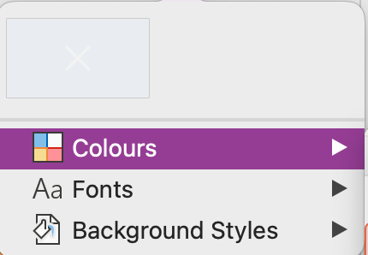
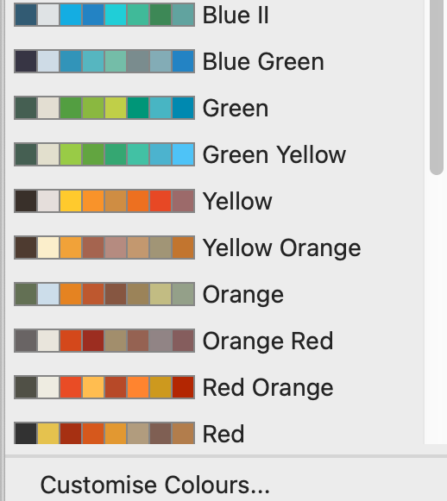
Choosing Colours
You can make your own colour scheme
Then use the design tab to input them to powerpoint
Notes:
I tend to choose a colour scheme I like and then manually check that it tracks in different types of colourblindness, but that’s just me! I then change the colours on my theme in powerpoint or whatever program I’m using so they’re all easily accessible and I don’t have to constantly put in hex codes

Slide 9
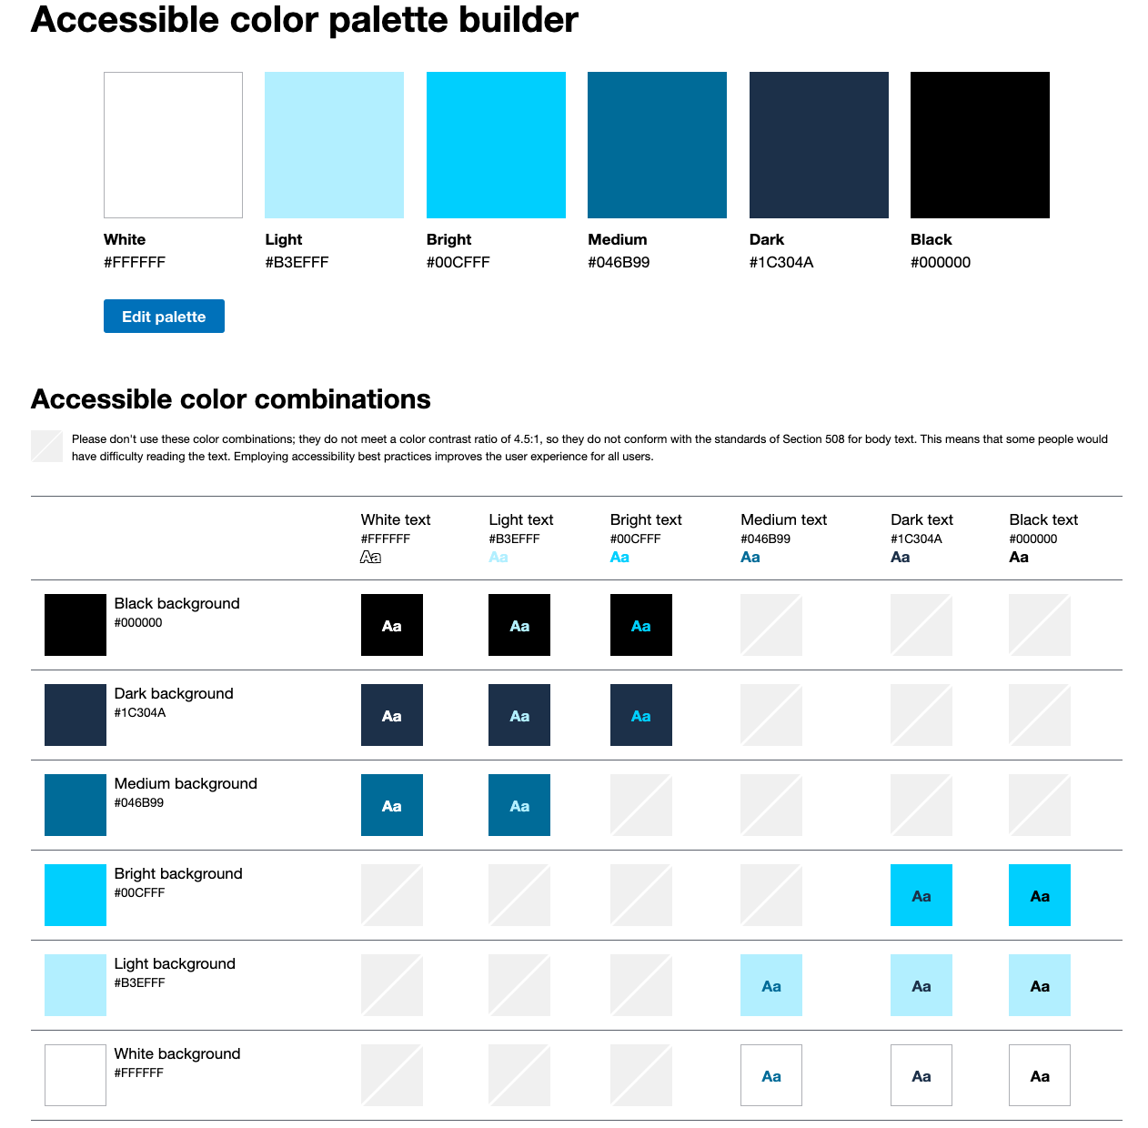
Choosing Colours
Colour palette builder
Checks contrasts to find good text / background colours
https://toolness.github.io/accessible-color-matrix/
Notes:
To check if your figures are colourblind friendly you can use the COBLIS colourblind simulator, it’s an online tool where you upload a figure and can then select several difference types of colourblindness to see what your figure would look like for people with that form of colourblindness, free to use!

Slide 10
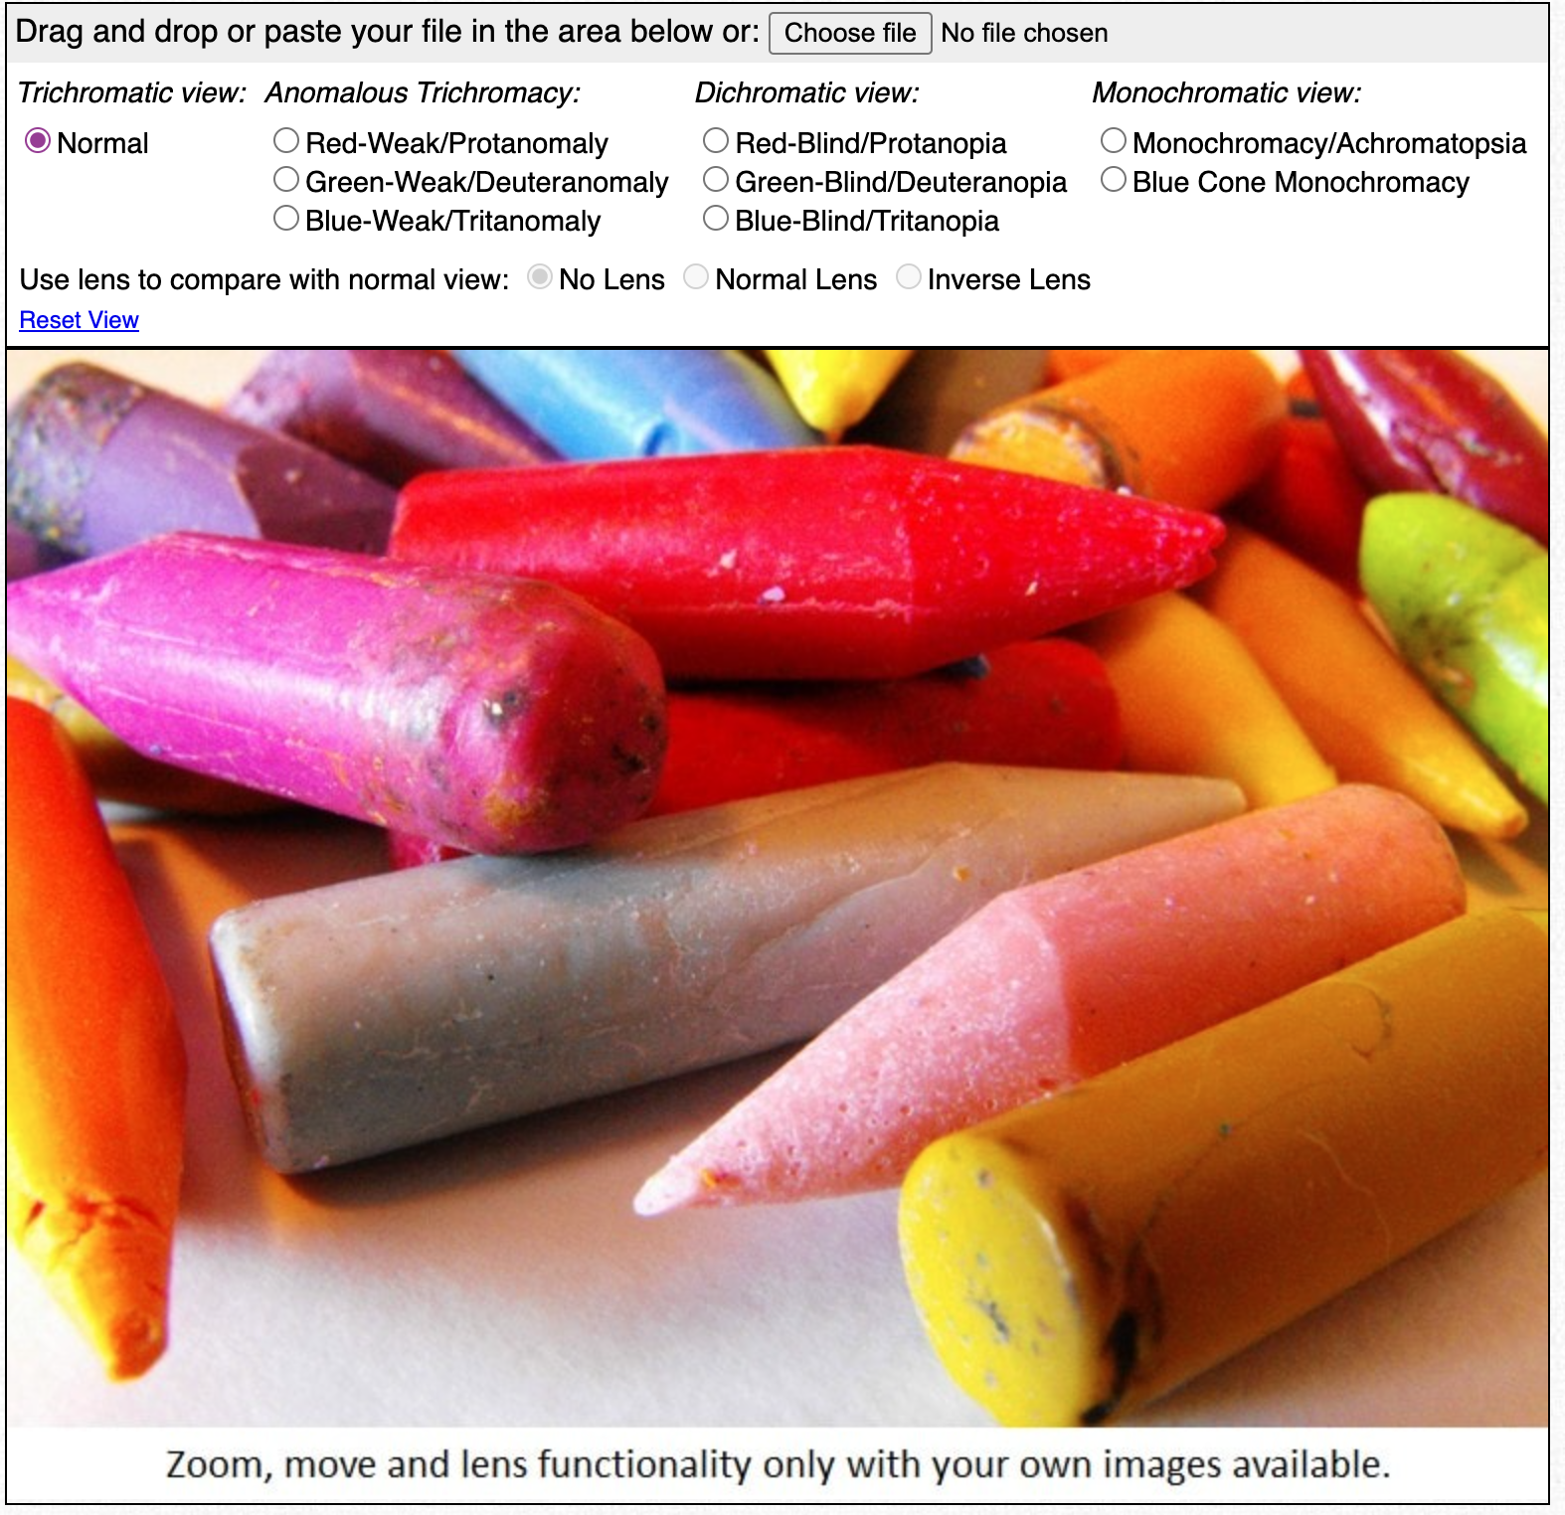
Colourblind Friendly Checks
COBLIS colourblind simulator
Upload a figure online
Simulate it for different deficiencies
https://www.color-blindness.com/coblis-color-blindness-simulator/
Notes:
To check if your figures are colourblind friendly you can use the COBLIS colourblind simulator, it’s an online tool where you upload a figure and can then select several difference types of colourblindness to see what your figure would look like for people with that form of colourblindness, free to use!

Slide 11
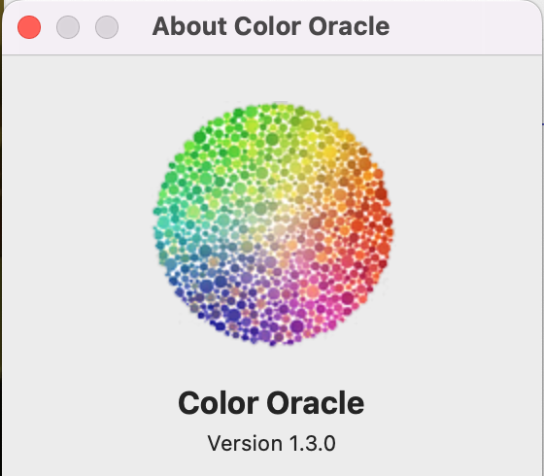
Colourblind Friendly Checks
Color Oracle
Free to download
Simulates 4 types of colourblindness directly on your screen
https://colororacle.org/index.html
Notes:
Color oracle also simulates colourblindness, it’s free to download on several operating systems. It simulates red, blue, & green deficiency as well as grayscale for your whole laptop screen, and you can just use the arrow keys to scroll between them or assign them to specific shortcut keys

Slide 12
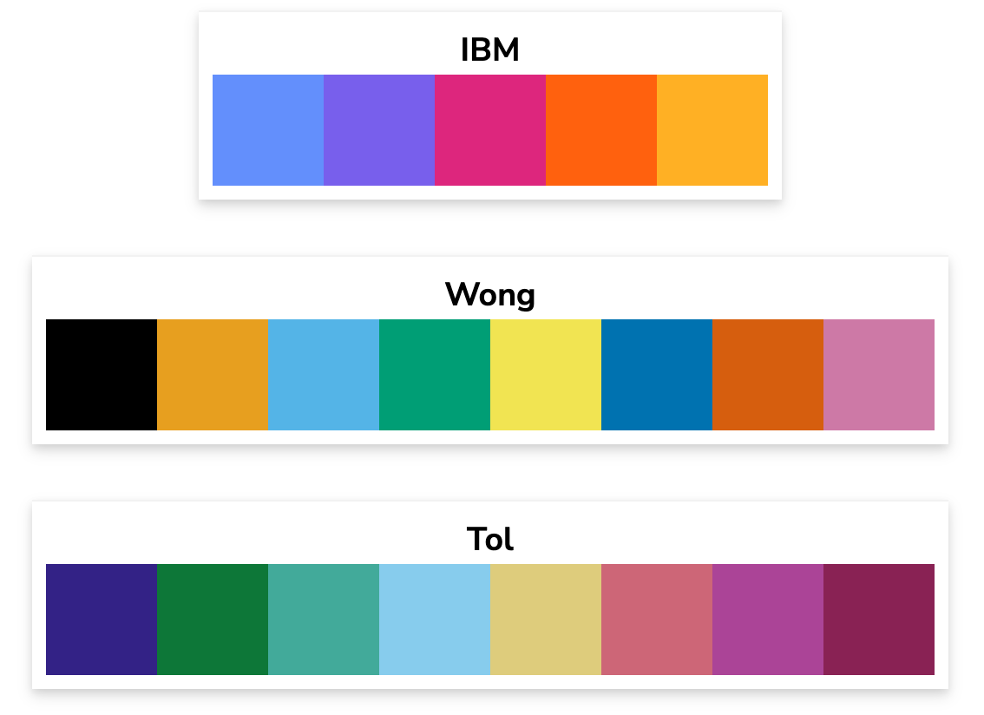
Choosing Colours
There are good colourblind friendly palettes online
https://davidmathlogic.com/colorblind/
Notes:
There are also really good ones online, this website has a few good ones and a good explanation about colour considerations for colourblindness. Alicia often uses the IBM one and I used to use the Tol one in my graphs

Slide 13
Python
Colour Schemes
Hex Codes
Cycler
Find the hex code for your colours
plt.plot(x, y, color=‘#b3b3b3’)
Define your own colour cycler
Then call colours with ‘C0’, ‘C1’
plt.rcParams[
'axes.prop_cycle'] = cycler(color = [‘#f89441', ‘#a82296’])
plt.plot(x, y, color=‘C1’)
Notes:
A lot of us make figures in python, and unfortunately, the default python plotting colourscheme isn’t particularly good for colourblindness so there’s two easy ways to put your own colourscheme into python
Just use the hex codes & pass them as input into your plotting function, that hex code is my favoured shade of grey for my graphs
Or: you can define your own colour cycler! You can put your entire palette, using their hex codes, into the colour cycler and then call your different colours using ‘C1’, ‘C2’, etc. It saves you having to retype your hex codes several times when making complicated plots

Slide 14
Fonts
Font choice is important
Sans serif fonts are more accessible
Different fonts will be better for different people

Slide 15
Fonts
Serif
Aa
Sans Serif
Aa
Sans serif fonts are easier to read for people with dyslexia or head injuries
Serif fonts can be used for large headings on posters

Slide 16
Fonts
Some good fonts include:
Arial
Helvetica
Courier
Verdana
Tahoma
Century Gothic
Comic Sans
Trebuchet
Calibri
Open Sans
OpenDyslexic
Computer Modern
Notes:
These fonts are good for a variety of reasons but in general, sans serif fonts with larger spacing between letters are good, monospaced fonts such as courier also tend to have a higher readability, comic sans has different angles for their letters, particularly for those that can often be confused such as i and j, opendyslexic is specifically designed for dyslexia and has heavier bottoms on letters, Computer modern is a serif font, which I wouldn’t recommend in general because sans serif fonts are better but [next slide]

Slide 17
Fonts
Computer Modern is the standard LaTeX font
It was found to be readable in a study into dyslexia-friendly fonts
The study can be found at: https://dyslexiahelp.umich.edu/sites/default/files/good_fonts_for_dyslexia_study.pdf

Slide 18
Figures
We need figures to communicate our research
They can be really pretty
A lot of figures are inaccessible!

Slide 19
Figures
There are three main issues with figures:
Overcrowded figures
Poor choice of colour scheme
Relying solely on colour

Slide 20
A Terrible Figure
Notes:
Here is a truly terrible figure, the data is fake but I saw one just like this in a paper recently. The main things wrong with it are: there are way too many lines on this graph, half of which show completely unrelated things, it is crowded and difficult to read with good eyesight and no colourblindness. The legend has distorted the space the graph takes up. The graphs relies only on colour to distinguish between the lines, which is a huge problem if you’re colourblind, so I’ll just show you how this graph looks if you’re green, red and blue deficient, and if you were seeing it in greyscale

Slide 21
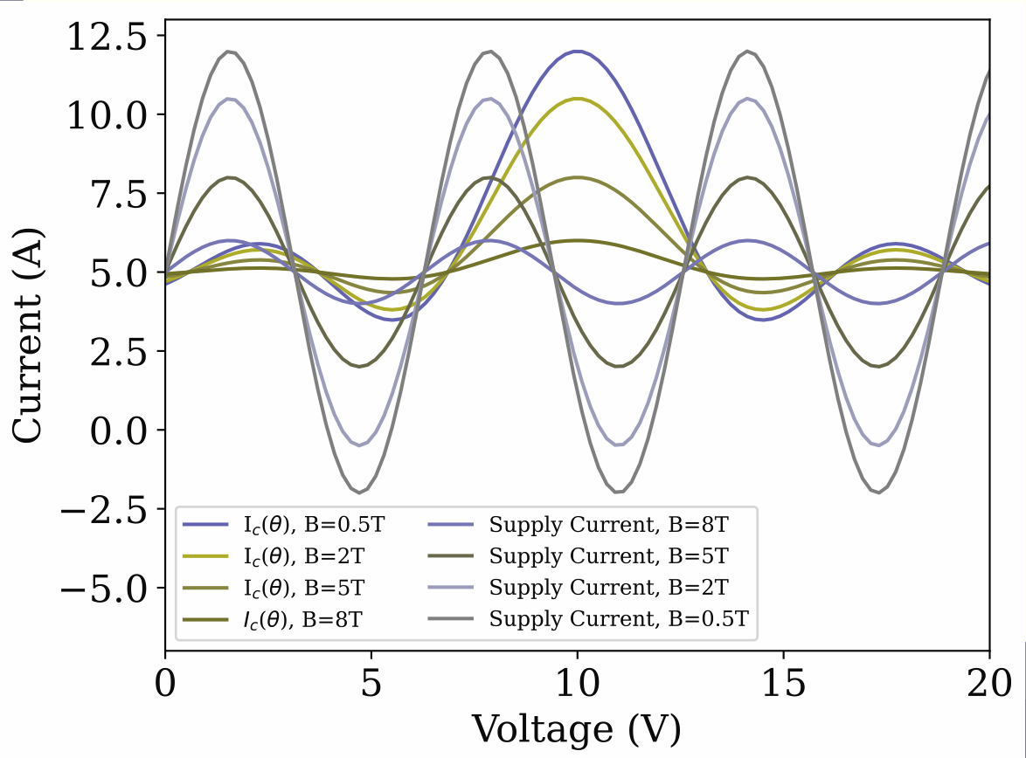
A Terrible Figure
Notes:
This is the same figure with green deficiency (5% of men)

Slide 22
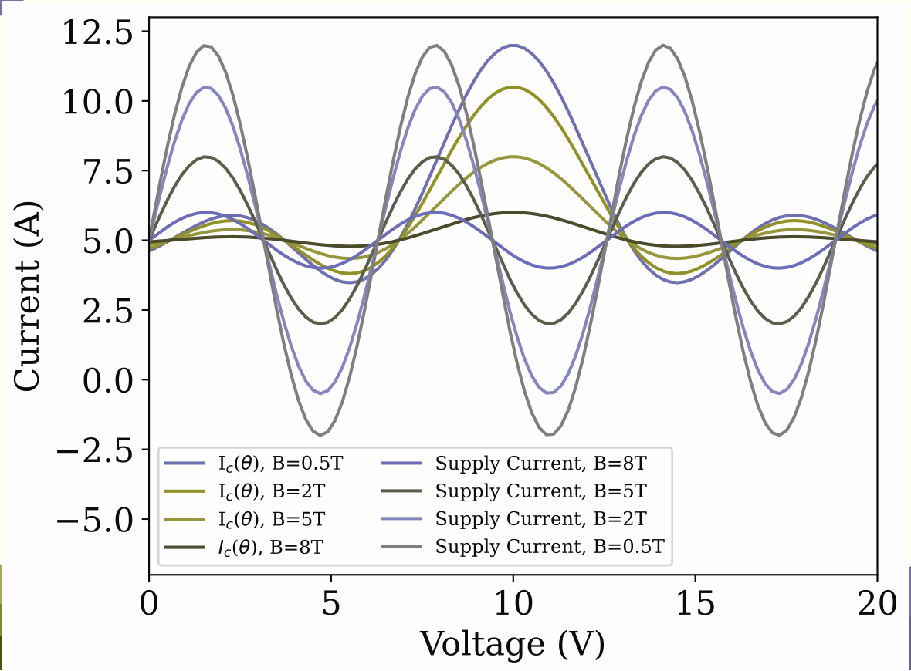
A Terrible Figure
Notes:
This is the same figure with red deficiency (2.5% of men)

Slide 23
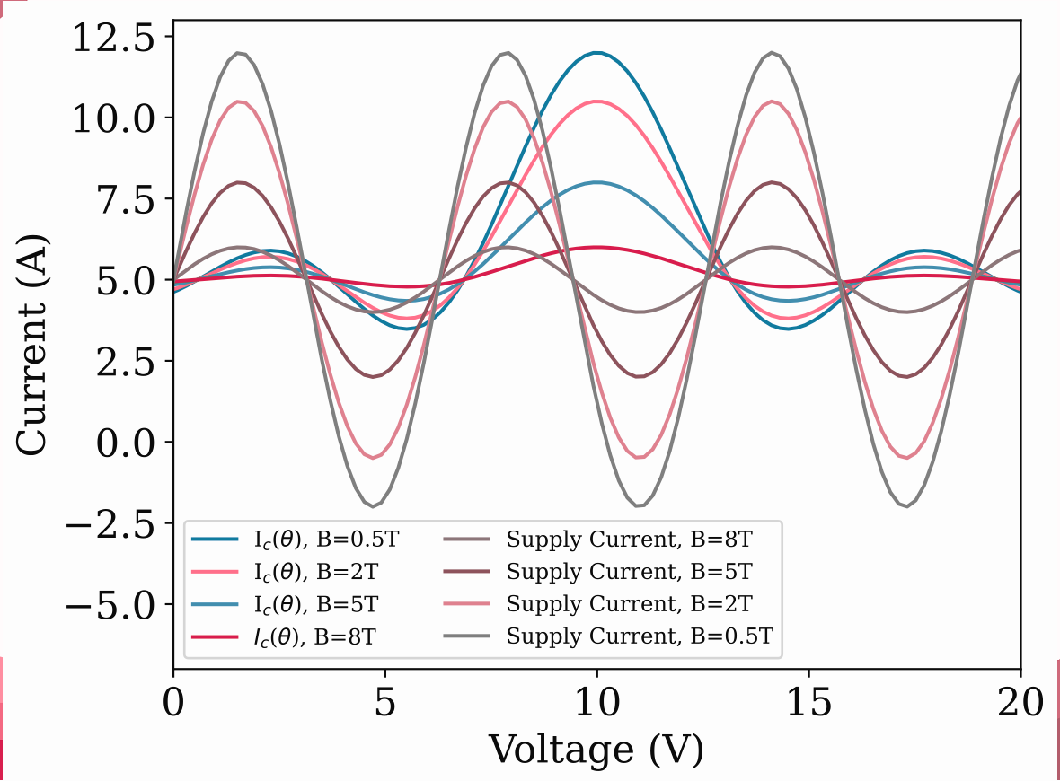
A Terrible Figure
Notes:
This is the same figure with blue deficiency (0.5% of men)

Slide 24
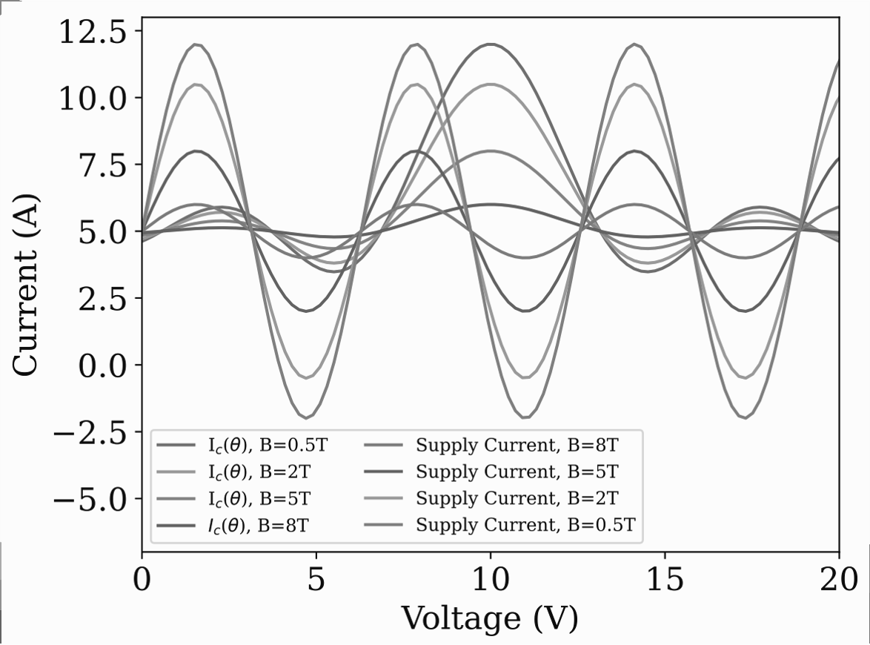
A Terrible Figure
Notes:
This is the same figure in grayscale. If you can’t see colour you stand absolutely no chance of understanding what this figure is telling you

Slide 25
Fixing the Figure
Change colour scheme
Add non-colour line distinguishers
Move legend
Make it a subplot figure
Notes:
To fix this figure and make it a lot more accessible I’m simply going to do 4 things: change the colour scheme, add non-colour line distinguishers, move the legend and make it into a subplot figure to separate the data in a useful way

Slide 26
A Better Figure
Notes:
This figure is better for a lot of reasons:
The colourscheme now holds for the main 4 types of colourblindness
Linestyles are also different, so you can distinguish the lines without needing to see the colours
The graph has been made into subplots separating the 2 sets of data, but still showing that they are related to each other
The colours for each magnetic field are now consistent for supply current & Ic, better showing they are related
Legend has been placed above the figure to not take up space inside or force distortion
It didn’t take me very long to fix this figure! It only took a couple of minutes :)

Slide 27
Slide Design
Don’t overcrowd your slides
Avoid too many animations or transitions
Make sure text is clear and readable
Notes:
In general there’s only a few key things to consider for slide design. Don’t overcrowd your slides, avoid too many animations or transitions, and make sure text is clear and readable. I’ll show you a couple of examples

Slide 28
Design Don’ts
Don’t put a wall of text on your slides, even if it’s been split into bullet points and is all deemed useful content, it’s hard to read and intimidating, especially if you’re talking at the same time and expanding on the content.
Remember to space out your bullet points with white space in between them, otherwise it can be difficult to know where one starts and one ends, particularly if your bullet point is small.
Avoid making your bullet points really long, it’s better to have more concise bullet points that you can expand on, than requiring everybody to read really quickly.
While slide animations and transitions can be really helpful, avoid having too many, such as each bullet point flying in, or star transitions between every slide.
Notes:
Don’t put a wall of text on your slides, even if it’s been split into bullet points and is all deemed useful content, it’s hard to read and intimidating, especially if you’re talking at the same time and expanding on the content.
Remember to space out your bullet points with white space in between them, otherwise it can be difficult to know where one starts and one ends, particularly if your bullet point is small.
Avoid making your bullet points really long, it’s better to have more concise bullet points that you can expand on, than requiring everybody to read really quickly.
While slide animations and transitions can be really helpful, avoid having too many, such as each bullet point flying in, or star transitions between every slide.

Slide 29
Design Dos
Use a small number of bullet points
Keep bullet points short and succinct
Add white space in between bullet points
Split information into multiple slides to improve design and readability
Notes:
Do use a small number of bullet points. Keep each bullet point short and succinct, you can always expand with what you say. Add white space in between bullet points to better divide them. If you’re creating e.g. lecture resources that will be uploaded online, it can be useful to have more detail in some slides, so I’d recommend splitting your information into multiple slides to improve design and readability

Slide 30
Fixing a Bad Slide
Notes:
I’m going to show an example of a slide that Alicia made recently that she gave permission to show that wasn’t very accessible and then we can do some things to fix the slides

Slide 31



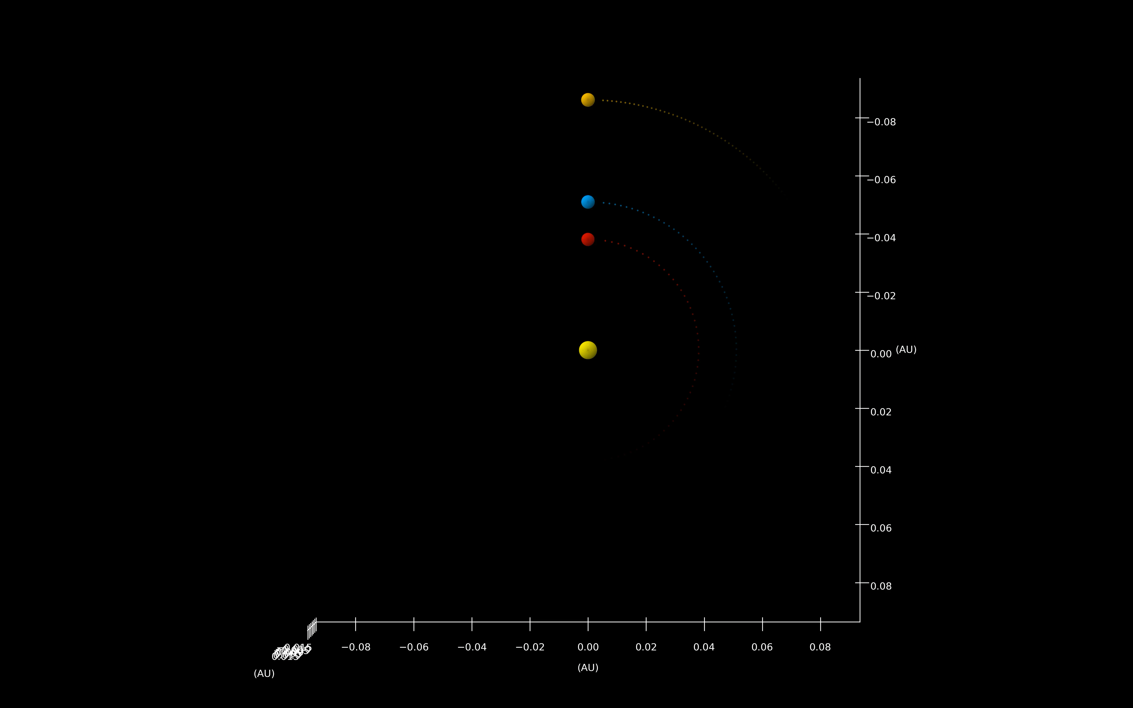


What I do:
3rd Year
Equitea co-founder ☕️
Office: F19B (the mini corridor by the stairs to the common room, cosy vibes)
Supervisor: Matt Burleigh
Part of NGTS gang 🤙🤙🤙
Looking for transiting exoplanets in photometry
Countless nights of observing remotely (and also in South Africa 🍷)
Still working on a ‘trash-to-treasure’ project rounding up missed TESS Objects of Interest in NGTS data → Hopefully doing some papers on a collection of Neptunes and Jupiters 😍
Writing a paper on three long period planets
Top Skills:
Python (especially matplotlib.3d.animate)
Allesfitter (fits all! → binaries, transiting exoplanets, RVs, flares and more)
Packages for stellar parameters: astroARIADNE, Pysynphot, Specmatch-EMP
Notes:
This was Alicia’s slide which isn’t great for a few reasons: the title font is difficult to read, and the body text font is a condensed font, and the thinner letters make it much less accessible. Her colour contrast is okay but could be improved. There is too much text on this slide and the text is really small, and it’s not screen reader friendly

Slide 32
Fixing the Slide
Change text colour for better contrast
Change fonts to sans serif non-condensed fonts
Increase body text font size
Split into two slides
Notes:
To fix the slide we are going to change the colour to have even better contrast, change the fonts to sans serif non-condensed fonts so they are easier to read, increase the size of the body text and split it into 3 slides

Slide 33
What I do:
3rd Year
Equitea co-founder ☕️
Office: F19B (the mini corridor by the stairs to the common room, cosy vibes)
Supervisor: Matt Burleigh
Part of NGTS gang 🤙🤙🤙
Looking for transiting exoplanets in photometry
Notes:
Here are the new slides, they are much easier to read and less intimidating because we’ve increased the text size, changed the font, and split the slides up to have less text on each

Slide 34
What I do:
Countless nights of observing remotely
Trash-to-treasure project for missed TESS objects in NGTS data 😍
Hopefully papers on a collection of Neptunes and Jupiters
Writing a paper on three long period planets
Notes:
Here are the new slides, they are much easier to read and less intimidating because we’ve increased the text size, changed the font, and split the slides up to have less text on each

Slide 35
Top Skills:
Python (especially matplotlib.3d.animate)
Allesfitter (fits all)
Packages for stellar parameters: astroARIADNE, Pysynphot, Specmatch-EMP
Notes:
Here are the new slides, they are much easier to read and less intimidating because we’ve increased the text size, changed the font, and split the slides up to have less text on each

Slide 36
Poster Design
Don’t put too much text on it
Ensure contrast between text and background
Make sure fonts are accessible and large enough
Split your poster into different sections
Notes:
We make a lot of posters and it can be difficult to figure out how to design them. Personally, I like to have a patterned background and then make coloured boxes for my content on top of those, but poster design and preferences varies greatly between different people. Here are 8 things to think about when designing your next poster: don’t put too much text on it, it means people are less likely to understand or even try to read your poster. Ensure good contrast between your text and its background, this will make it readable and also make it stand out. Ensure your fonts are accessible and large enough, often people use a serif font for headings (which is okay provided they’re large enough!) and the a sans serif font for body, or a sans serif font throughout, and split your poster into different sections to make it easier to read and more visually appealing.

Slide 37
Poster Design
Ensure titles stand out against body text
Make sure elements are aligned
Make the reading order clear
Use graphics to make it more interesting
Notes:
Ensure your titles stand out against body text, that may be using a different font, different colour, making them larger, putting them on a banner or in a different colour box. Make sure your elements are aligned, so if you use boxes or columns they are aligned. Make your reading order clear – if you have a large central elements and other boxes as a sunray around it it can be difficult to know where to start. Use graphics to make your poster more interesting, this includes both figures and also little icons

Slide 38

Notes:
Here’s an example of a bad poster design from the university of Newcastle, it’s very overcrowded with text and although it’s structured and aligned, with a reasonable colour scheme, it’s too busy and not visually engaging.

Slide 39

Notes:
Here’s an example of the same poster, but improved (also by Newcastle university). There is now something other than text, there’s a lot less text which makes it more readable, the QR code can add extra info for those really invested. All in all, it’s a much better design, and their icon graphics are nice as well

Slide 40
Screen Reading
Some people will rely on screen readers
Alt text should be added to all figures to describe them to screen readers
Need to define correct screen reading order for powerpoints and posters
Notes:
Screen reading is an important thing to consider, and many people rely on screen readers. If you think about a pdf, or a word document or a text-based document, the screen reading order is easy and logical. However, for things such as powerpoints and posters where you have may have multiple columns, or several parts on a slide that need to be read in a specific order, we should check that it will be read in the order we intend. This may sound hard but it can be done really easily with powerpoint’s accessibility checker which I will show you

Slide 41
Accessibility
Checker
In-built powerpoint tool to check accessibility
Flags poor colour contrast, missing alt text, and reading order queries
Can be accessed in the review tab
Notes:
Powerpoint has an in-built accessibility checker which will highlight issues such as poor colour contrast, missing alt text on images, places where it’s unsure of the order you want for a screen reader, amongst other features such as officially setting slide titles for screen readers. You can access it in the review tab

Slide 42
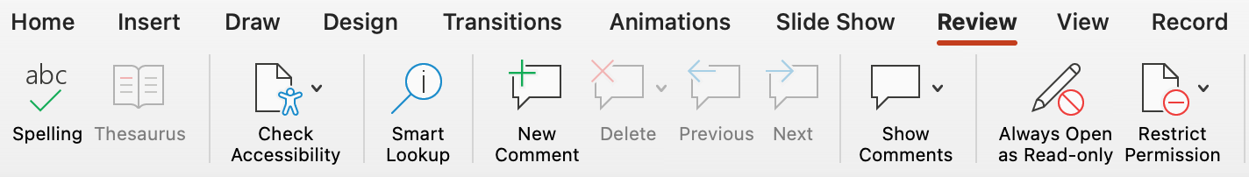
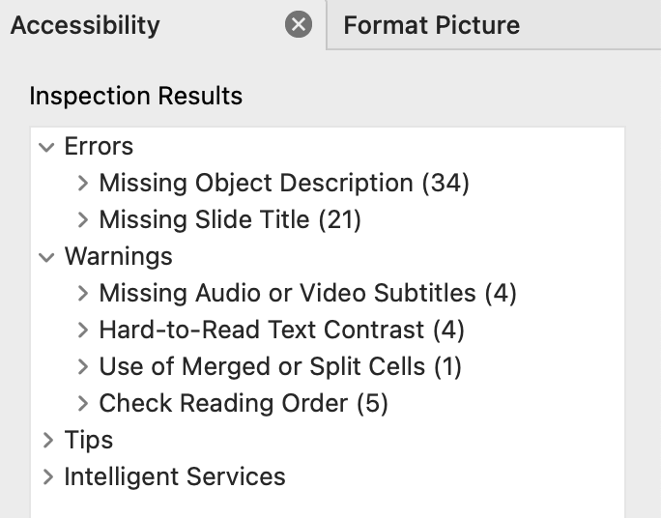
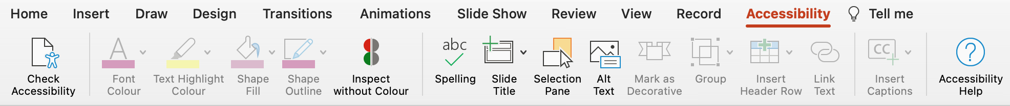
Click Review
Accessibility
Checker
1.
2.
Click Check Accessibility
Notes:
To get to the accessibility checker, click review in the banners at the top, then click check accessibility and you will be in the accessibility tab. An accessibility pane will show up to your right and look like this; it has highlighted (and I have fixed all of these) missing object descriptions for icons or items I’ve grouped together, missing slide titles where I need to tell powerpoint my title-looking thing is in fact the title so it knows for screen reading, hard-to-read contrast, and places where I needed to tell the screen reader the reading order, such as for this slide where it has images and text in an unexpected order

Slide 43
Accessibility
Checker
3.
In Accessibility pane, click Check Reading Order
4.
Go into home tab, arrange, selection pane to then change your reading order
Notes:
You can then click check reading order, and it will highlight the slides which have issues. You can then get to the selection pane (and it tells you how todo this in the checker), and move all of your objects around until they are in the correct order – beware that for this, the bottom of the selection pane is read first, but it tells you this.

Slide 44
Where to find our resources
All of our resources can be found on our websites
linktr.ee/equiteauol (QR code on our posters)
equitea-university-of-leicester.github.io
Includes this presentation and all resources mentioned today
Notes:
This presentation, along with the recording of this meeting, and all of the resources we have mentioned, plus some others, are available on our website! You can get there from our linktree (which is where the QR code on all of our posters will lead you), or you can directly access the github site. It’s still under construction so please be kind about it!

Slide 45

NEXT SESSION:
Being Trans in Academia
A talk from Ares Osborn (he/they, University of Warwick) about what it’s like being a transgender person in academia right now, and how allies and institutions can offer support.
12th December F10/11 Time tbc

Slide 46



QUESTIONS? CONTACT US!
Jenni French (she/her) jf328@le.ac.uk |  |  | Hannah Lerman (she/her) hnl4@le.ac.uk
Alicia Kendall (she/her) ak842@le.ac.uk |  | EDI Physics equalities-physics@leicester.ac.uk
TRANS RIGHTS ARE HUMAN RIGHTS

